Slide 1
Hospitality

Slide 2
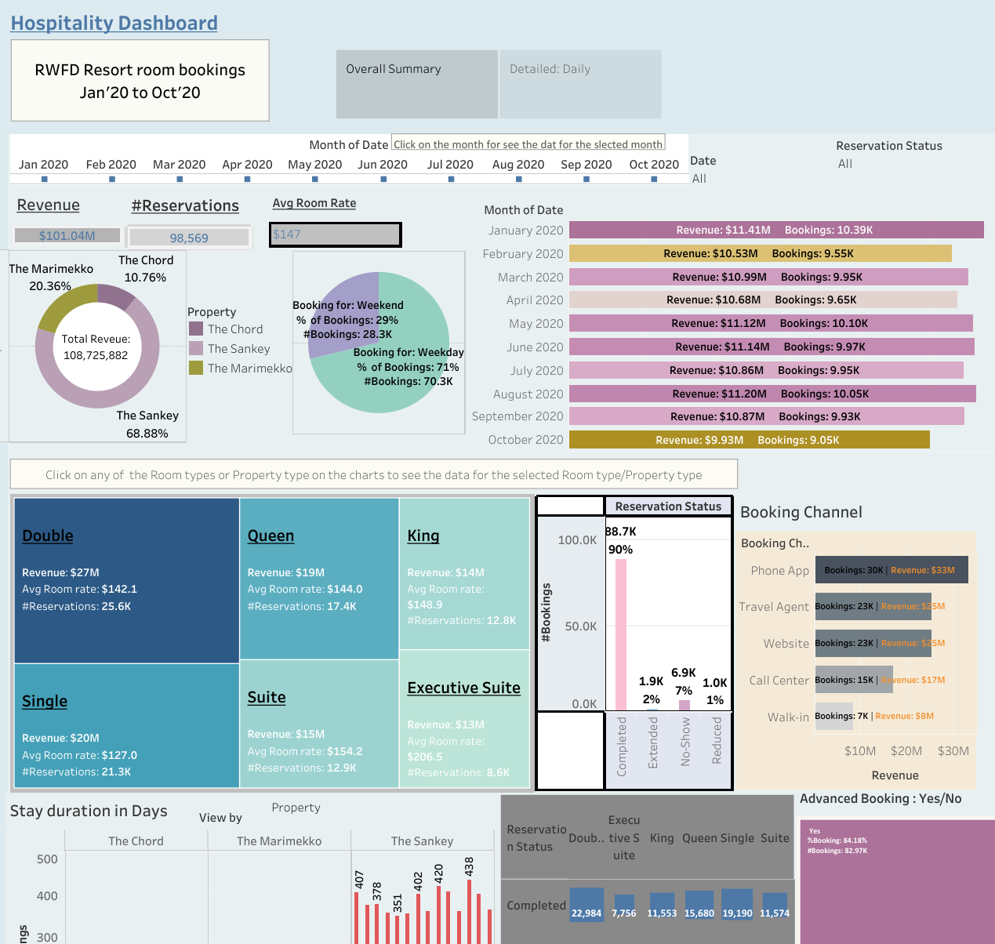

Slide 3
